Slide 1
English grade 3
Stand up!
Unit 6
Lesson 2

Slide 2
Vocabulary

Slide 3
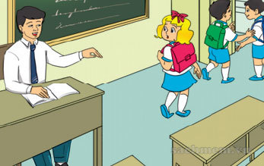
English 3
Vocabulary
Come here

Slide 4
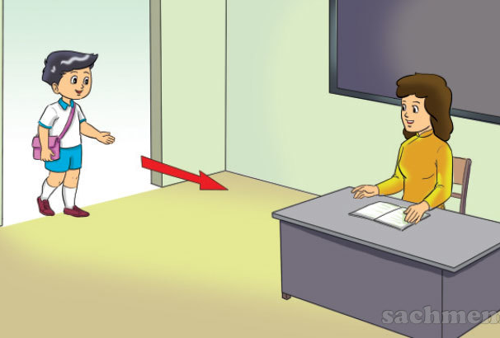
English 3
Vocabulary
Come in

Slide 5
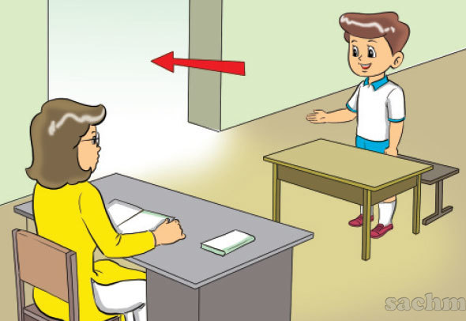
English 3
Vocabulary
Go out

Slide 6
English 3
Vocabulary
Write

Slide 7
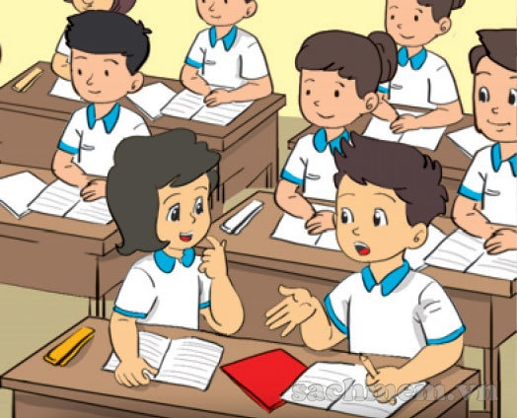
English 3
Vocabulary
Speak

Slide 8
Vocabulary
Come here
Write
Speak
Go out
Come in

Slide 9
structure

Slide 10
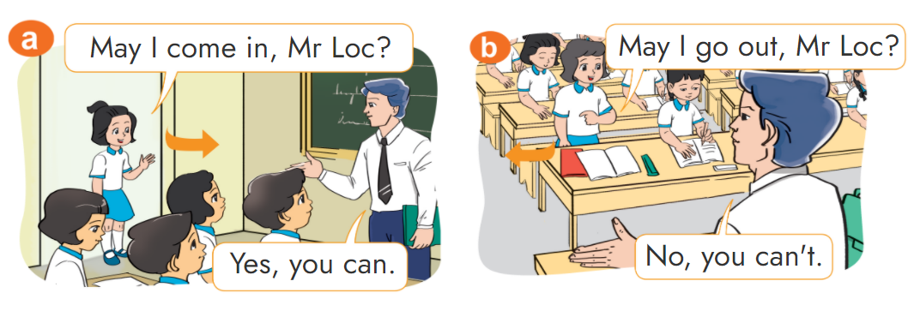
1. Look, listen and repeat.

Slide 11
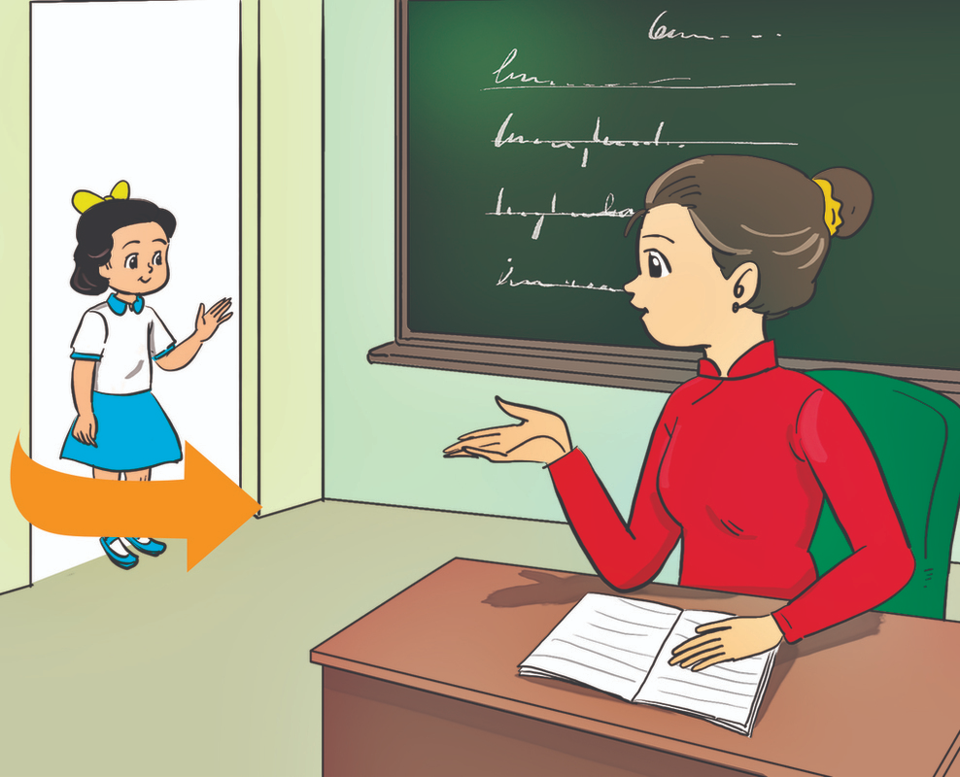
2. Point and say.
come in
May I ___________?
Yes, you can.

Slide 12
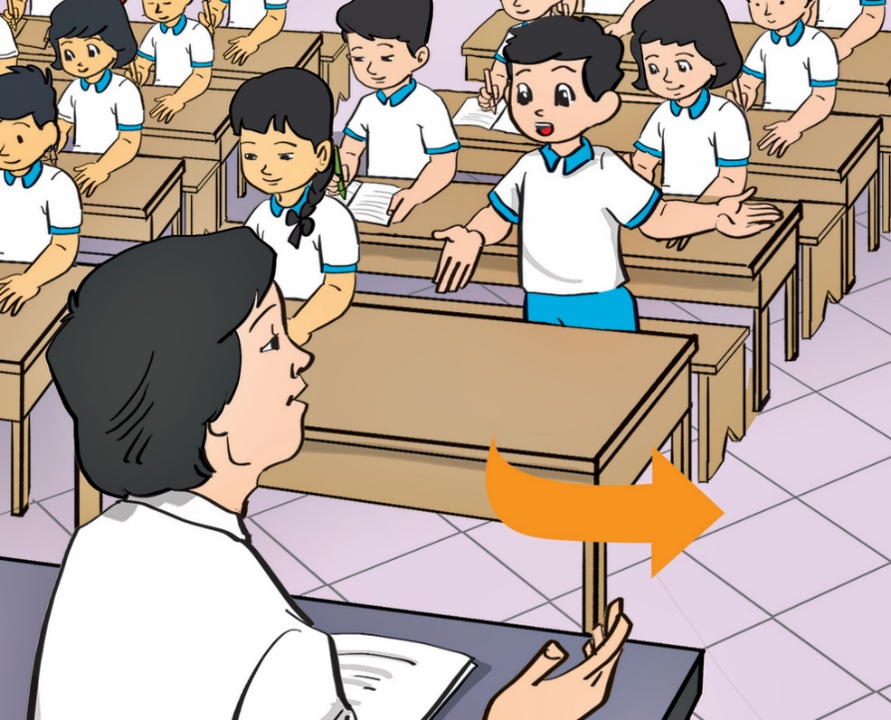
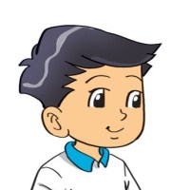
2. Point and say.
go out
May I ___________?
Yes, you can.

Slide 13
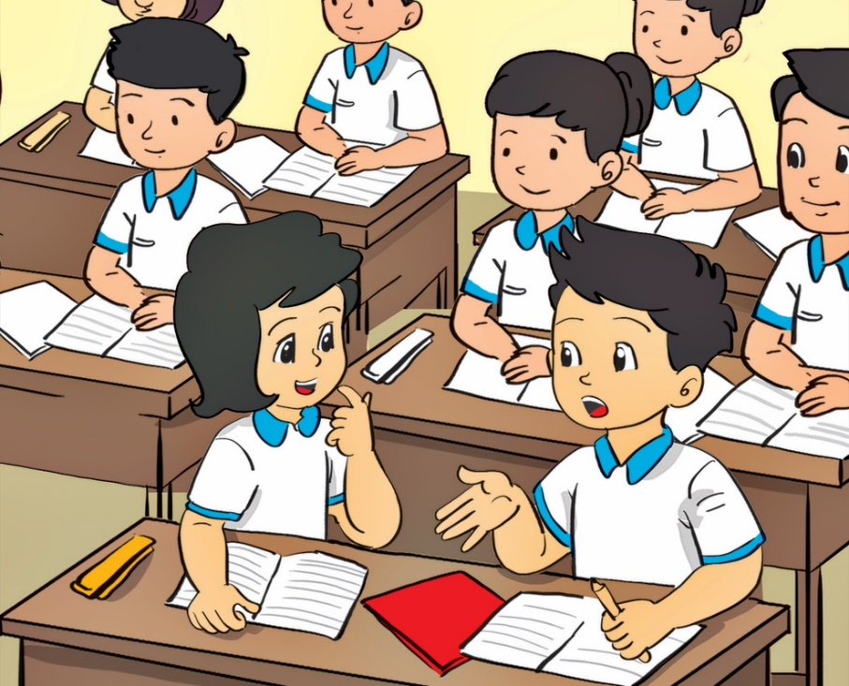
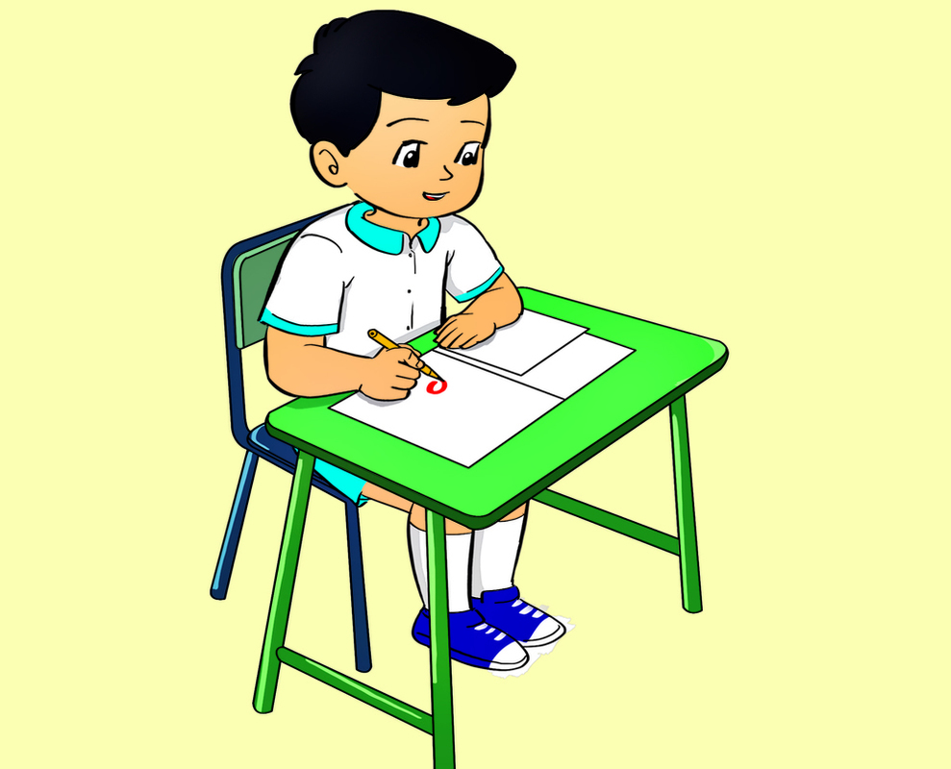
2. Point and say.
speak
May I ___________?
No, you can’t.

Slide 14
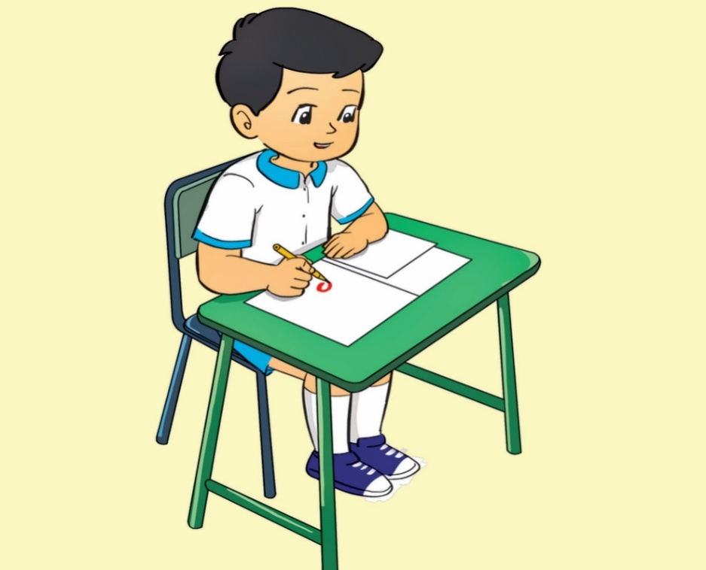
2. Point and say.
speak
May I ___________?
No, you can’t.

Slide 15
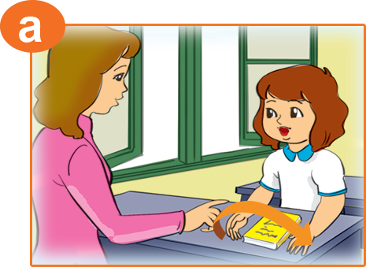
May I open the book?
3. Let's talk.
May I _________________?
open your book
No, you can’t.
Yes, you can.
_______________.
Yes, you can. / No, you can't.

Slide 16
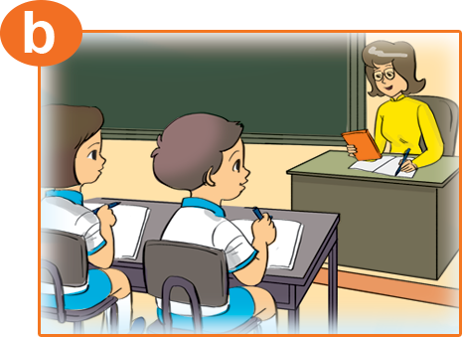
May I open the book?
3. Let's talk.
write
May I _________________?
No, you can’t.
Yes, you can.
_______________.
Yes, you can. / No, you can't.

Slide 17
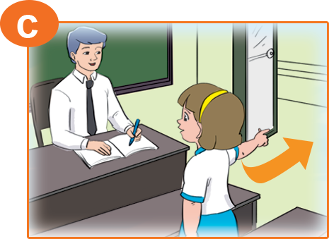
May I open the book?
3. Let's talk.
go out
May I _________________?
No, you can’t.
Yes, you can.
_______________.
Yes, you can. / No, you can't.

Slide 18
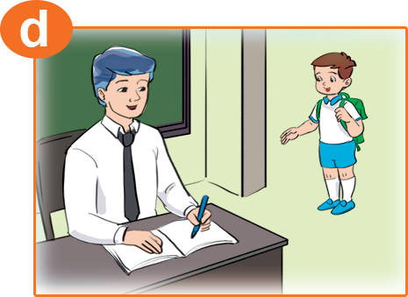
May I open the book?
3. Let's talk.
come in
May I _________________?
No, you can’t.
Yes, you can.
_______________.
Yes, you can. / No, you can't.

Slide 19
Đi tìm PIKACHU

Slide 20
May I write?
Yes, you do.
No, you cann’t.
Yes, you can.

Slide 21
May I speak?
No, you can’t.
No, I can’t.
Yes, You can.

Slide 22
May I come in?
Yes, you can’t.
Yes, you can.
No, you can’t.

Slide 23
May I go out.
Yes, I can.
Yes, you can.
No, you can’t.

Slide 24
May I come in?
No, I can’t.
No, you can.
No, you can’t.

Slide 25
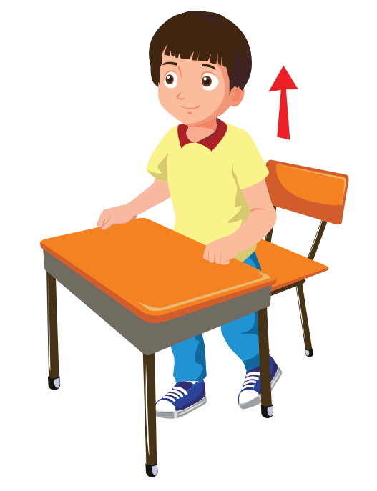
Yes, you can.
May I stand up?
May I sitdown, please?
I stand up, please?

Slide 26
Yes, you can.
May you open
my book?
May I open
my book?
Open
your book, please?

Slide 27
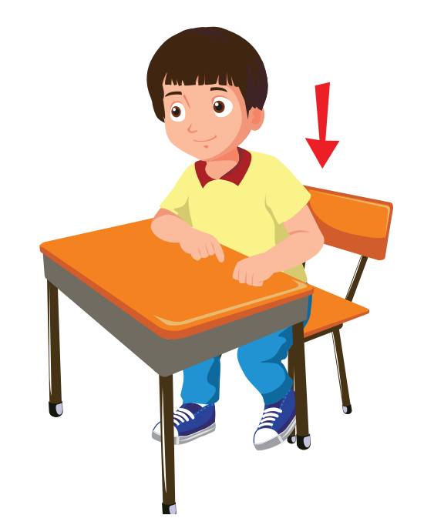
No, you can’t.
May I sit down?
Sit down, please?
I sit down?

Slide 28
No, you can’t.
Close
your book, please.
I close
your book?
May I close
your book?

Slide 29
Excellent!

Slide 30
4. Listen and number.
4
1
2
3
1
2
3
4

Slide 31
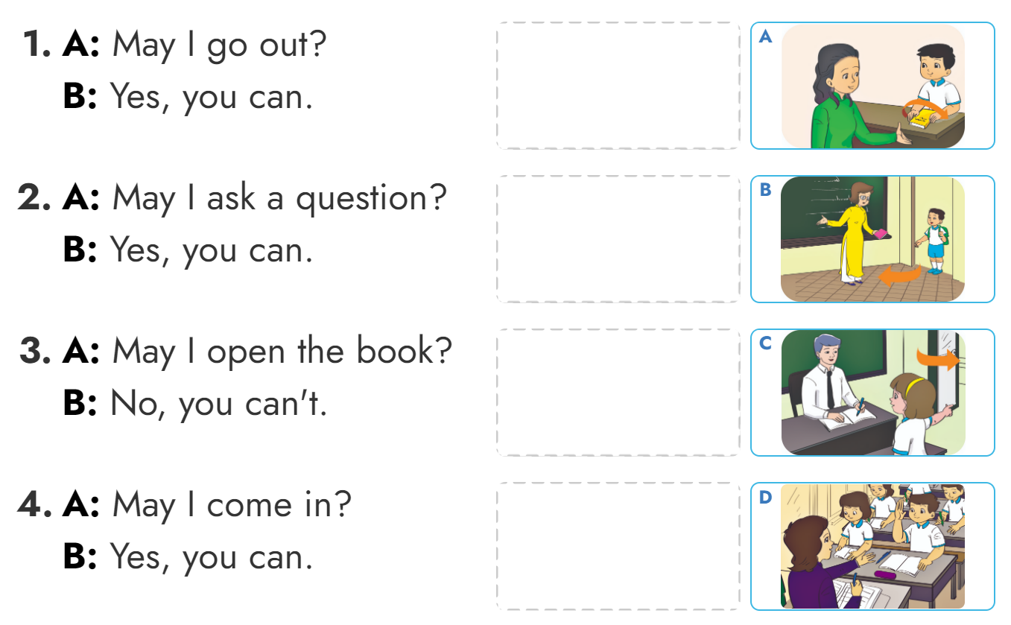
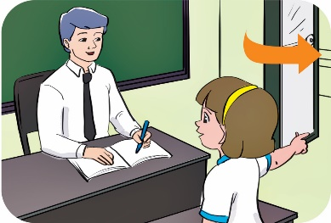
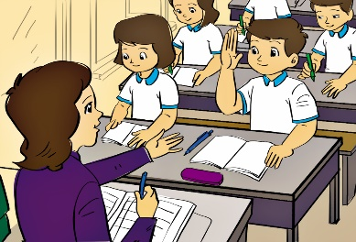
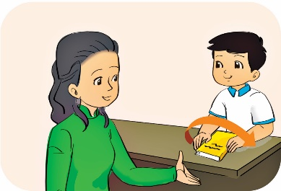
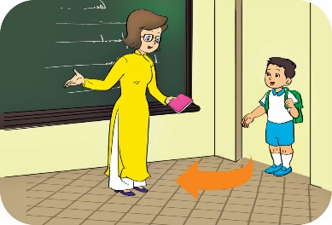
5. Read and match.
C
D
A
B

Slide 32
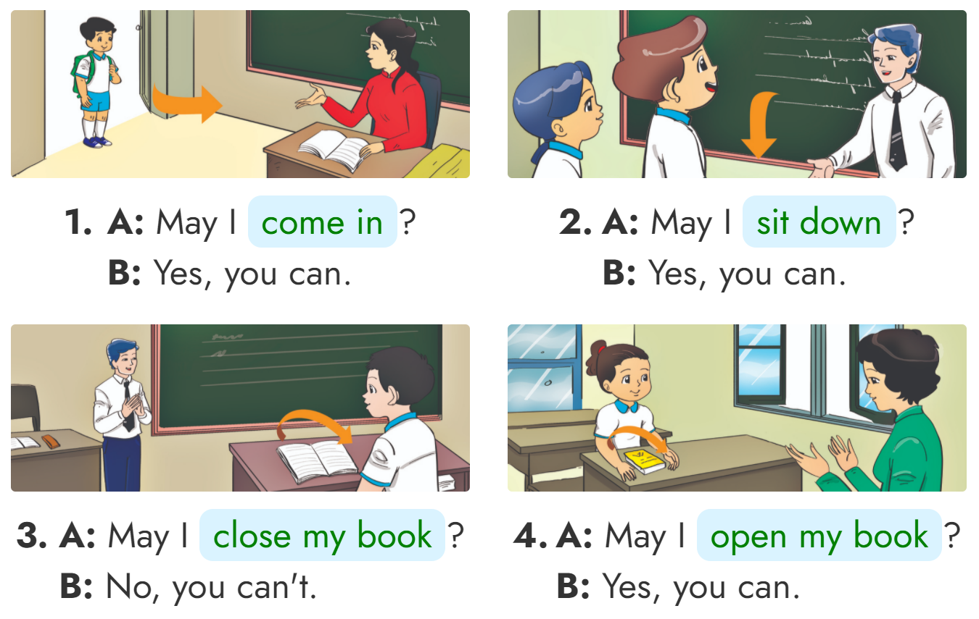
6. Let’s write
__________
__________
_______________
_______________

Slide 33
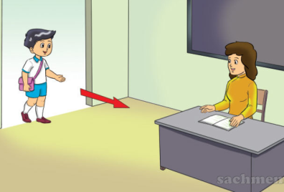
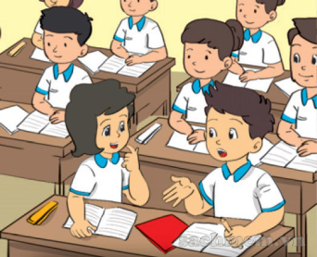
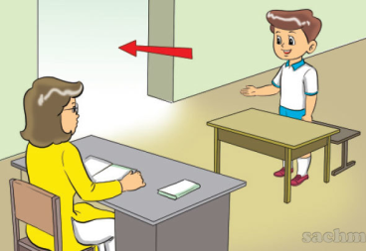
English 3
Structure
Yes, you can.
May I ______?
No, you can’t.
Come in
Write
Speak
Go out

Slide 34
THANK YOU!
Welcome to join with me!

